Slide 1



Inside Jira Service Desk:
Transforming Customer Support with Artificial Intelligence
Maruthi B G |
Technical Lead |
ALD/AFS

Slide 2










Which is better?
A N D

Slide 3





Agenda
Introduction to AI
Including Machine Learning and Natural Language Understanding
Examples
Three use cases for intelligent systems within Customer Support
Implementation
How to integrate AI with our own Jira Service Desk deployment

Slide 4
Introduction to
Artificial Intelligence

Slide 5

noun
ARTIFICIAL INTELLIGENCE
The theory and development of computer systems able to perform tasks normally requiring human intelligence

Slide 6







Machine Learning
DATA
ALGORITHM
PREDICTION

Slide 7
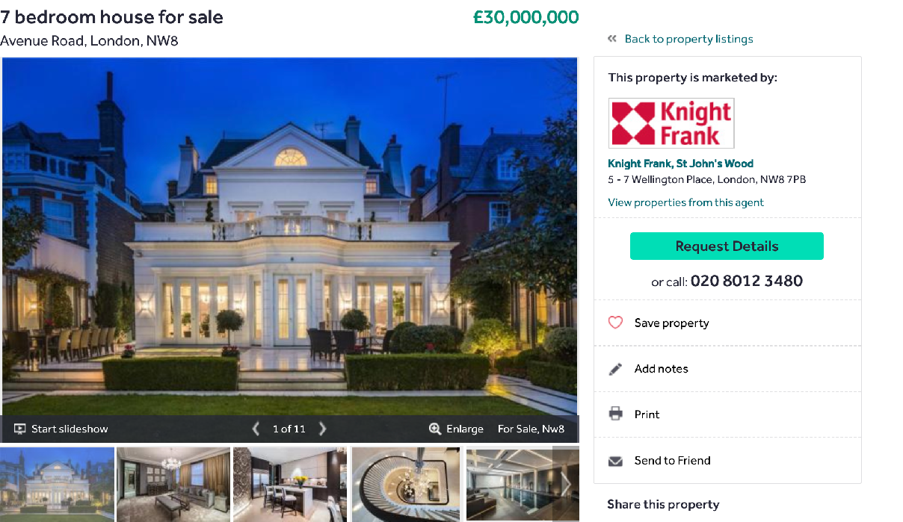
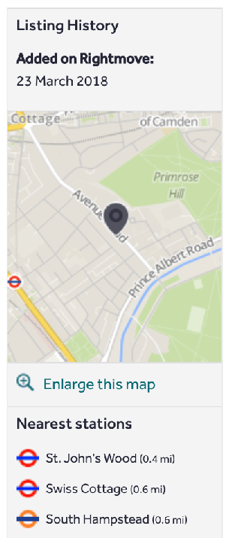
An ambassadorial residence on a very generous
plot, designed to reflect its prestigious surroundings. The property contains
, and a large
1000 sq metre
7 bedrooms
4 en-suite bathrooms
swimming pool.

Slide 8
Property Type
Public transport
Bathrooms
Bedrooms
Area
Pool?
Value
H
1000 7
4
1
0.4
£30 M
An ambassadorial residence on a very generous
plot, designed to reflect its prestigious surroundings. The property contains
, and a large
1000 sq metre
7 bedrooms
4 en-suite bathrooms
swimming pool.

Slide 9
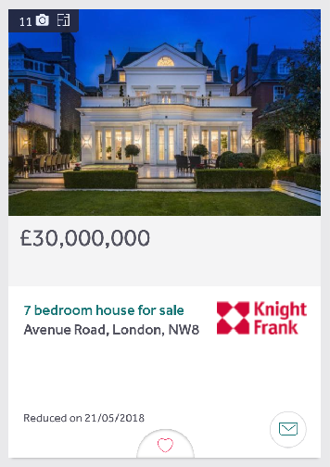
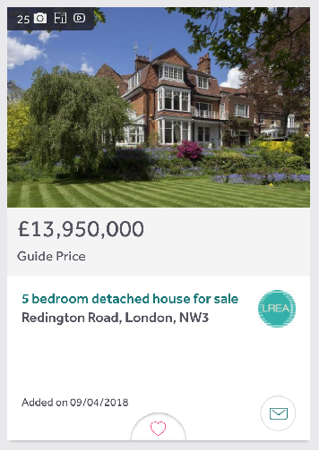

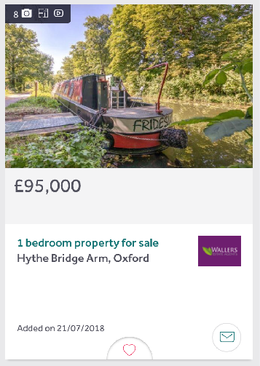
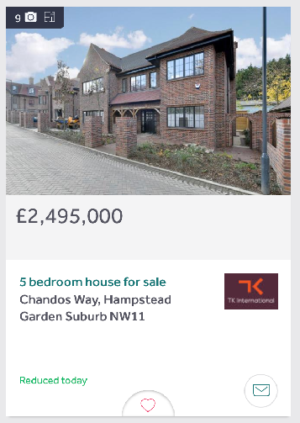
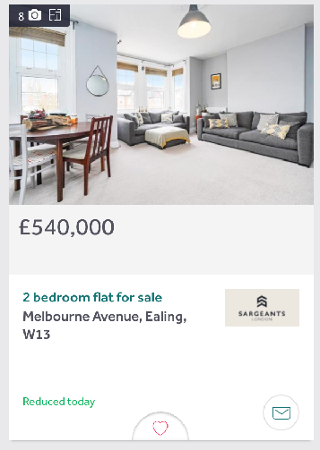
Property Type
Public transport
Bathrooms
Bedrooms
Area
Pool?
Value
H | 1000 | 7 | 4 | 1 | 0.4 | £30 M
H | 870 | 5 | 3 | 0 | 1.5 | £14 M
A | 600 | 4 | 2 | 0 | 0.1 | £13 M
B | 120 | 2 | 1 | 0 | 0.9 | £90 k
H | 700 | 5 | 2 | 0 | 0.43 | £3 M
A | 450 | 2 | 1 | 1 | 0.4 | ???
???

Slide 10
Property Type
Public transport
Bathrooms
Bedrooms
Area
Pool?
Value
H | 1000 | 7 | 4 | 1 | 0.4 | £30 M
H | 870 | 5 | 3 | 0 | 1.5 | £14 M
A | 600 | 4 | 2 | 0 | 0.1 | £13 M
B | 120 | 2 | 1 | 0 | 0.9 | £90 k
H | 700 | 5 | 2 | 0 | 0.43 | £3 M
A | 450 | 2 | 1 | 1 | 0.4 | £540k
£540k

Slide 11

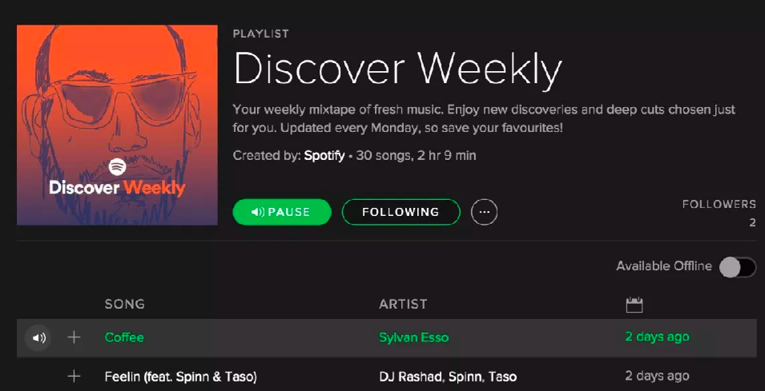
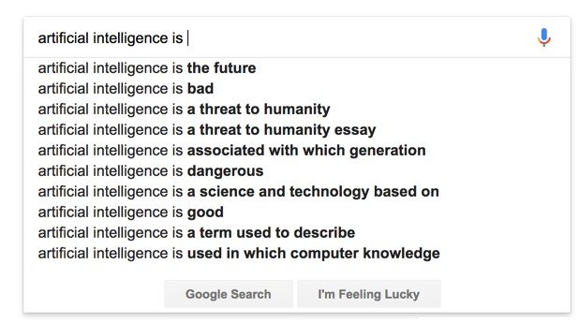
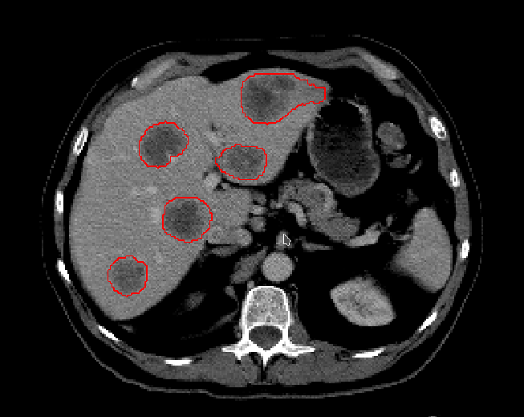

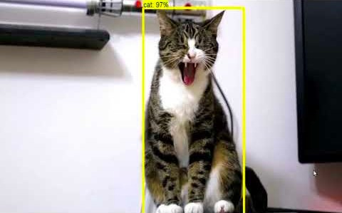

Slide 12
Three examples of application in customer support

Slide 13
























Example 1
Skills based ticket routing
Permissions
Performance

Slide 14






































Support Tickets
Queue Master
Permissions
Performance

Slide 15





Predicting the topic
To: From:
Atlassian Support Customer
Subject: Space question
Message:
Ticket 1
I'm having problems with space permissions in Confluence.
Ticket 2
I cannot create a blog in my space.
Can you help?
Ticket 3

Slide 16







Predicting the topic
To: From:
Atlassian Support Customer
Subject: Instance unresponsive
Message:
Ticket 1
Hello,
Our Jira instance has become very slow. We have tried re-indexing but that didn't improve performance.
Ticket 2
Ticket 3
Thank you!

Slide 17



Predicting the topic
To: From:
Atlassian Support Customer
Subject: Article access
Message:
Ticket 1
Our customer cannot browse knowledge base articles anymore. They receive an error page "Permission Violation" which says:
Ticket 2
“Sorry, you don't have permission to perform that action. If you think you should have permission, contact your administrator.”
Ticket 3
Thanks :)

Slide 18










Admin
Space
Permissions
I'm having correct
trouble
granting a user the to allow her to
permissions
within a are screenshots of the have set.
Attached
I
Support Tickets
Automated classification
Permissions Performance
delete pages
space.
Automated classification
permissions

Slide 19



Support Tickets
Automated classification
Permissions
Performance

Slide 20






Impact
Customer
Saves time
Business
Saves money

Slide 21












Example 2 Knowledge

Slide 22
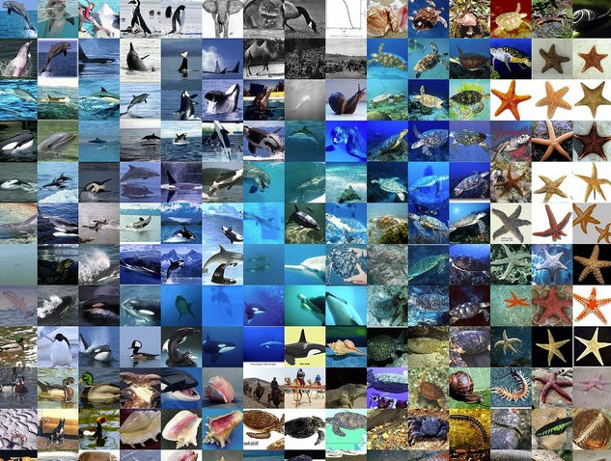
Credit: Gene Kogan github.com/genekogan/ofxTSNE

Slide 23

Credit: Gene Kogan github.com/genekogan/ofxTSNE

Slide 24
Knowledge Article
Related articles appear close together
GDPR
2cbda163-b937-4e7f-b603-7f49c39e78d2
The greatest
Euro Summit Bash
events of all time

Slide 25
Knowledge Article
Potentially useful articles near tickets
Related knowledge
Ticket
Related knowledge

Slide 26







ONE SIDE
Use when explaining two sides of a point.
RECOMMENDATIONS
Managing Global Permissions
Global permissions are system-wide and are granted to groups of users. You can refer to project permissions to manage permissions that apply to individual projects.
Jira Permissions General Overview
JIRA has a flexible security system which allows you to configure who can access JIRA, and what they can do/see within JIRA.
Not able to bulk edit Team field in Jira
Attempting to update the Team field in a bulk edit is not possible at the moment
Managing project permissions
Project permissions are created within permission schemes, which are then assigned to specific projects by Jira Administrators.
To: From:
Atlassian Support Customer
Subject: Jira permissions
Message:
How can I make bulk permission changes to a single Jira project?

Slide 27













Related Content
While browsing a knowledge base
Self service
For easy to resolve tickets
Support Staff
Help support engineers find documentation faster

Slide 28































Example 3
Topic Discovery

Slide 29
Knowledge Article
Support Ticket
Clustering

Slide 30


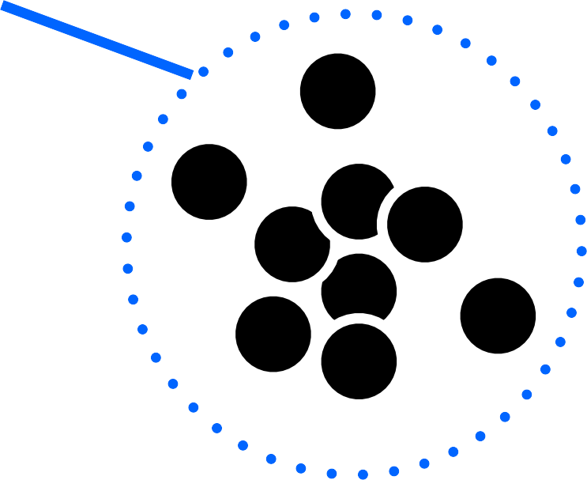
Knowledge Article
Support Ticket
Clustering
No related knowledge

Slide 31
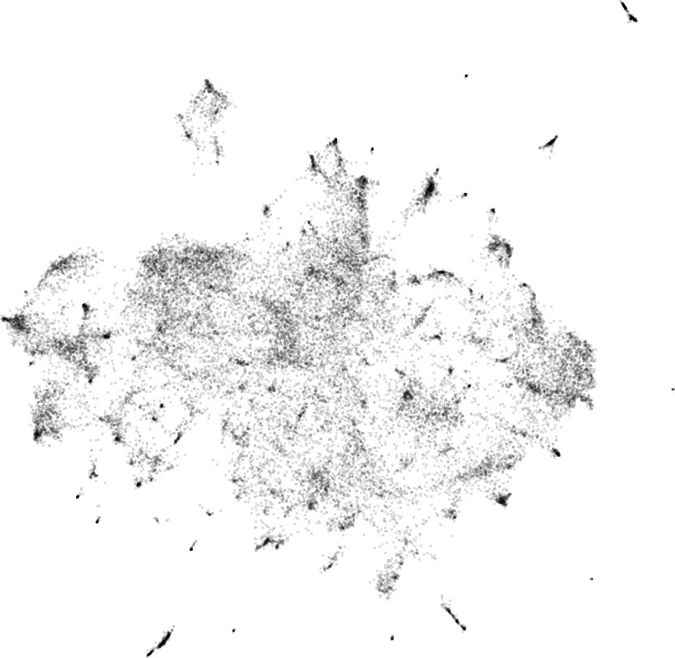
Support Tickets
Backup
Team Calendar
Gliffy
Permissions
Notifications
SAML Authentication
New Users
Billing
Disk Space
Import from Word
Sprint Reports
Language
Site down

Slide 32
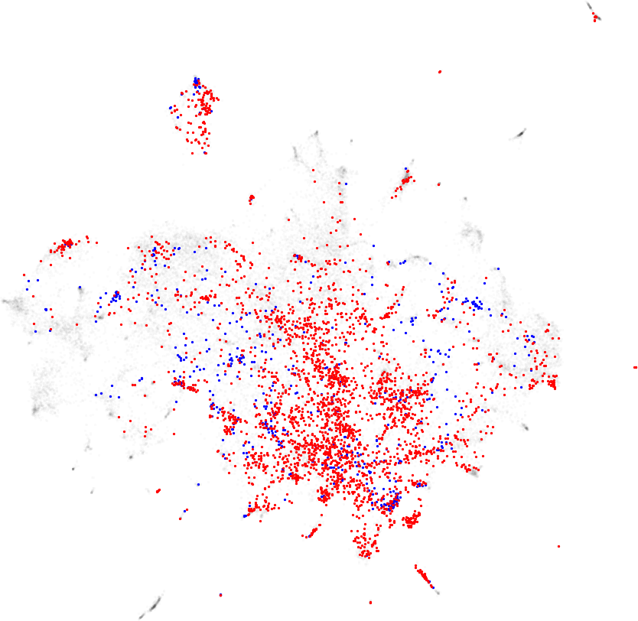
Support Tickets
Knowledge Article Bug
Backup
Team Calendar
Gliffy
Permissions
Notifications
SAML Authentication
New Users
Billing
Disk Space
Import from Word
Sprint Reports
Language
Site down

Slide 33
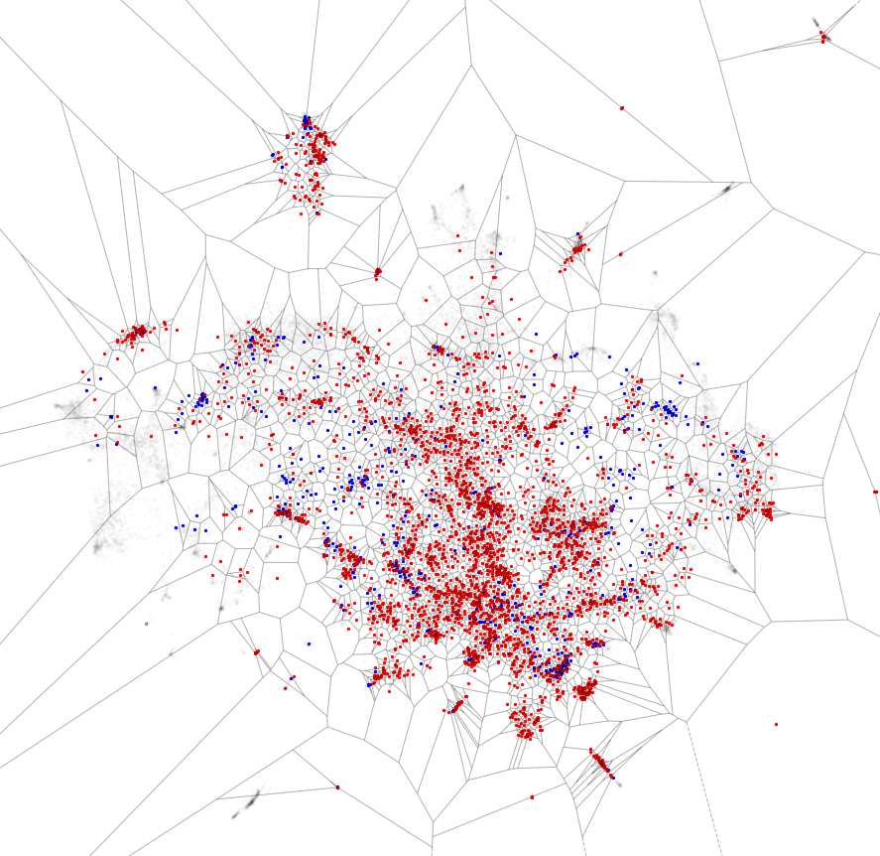
“Region of Influence”

Slide 34
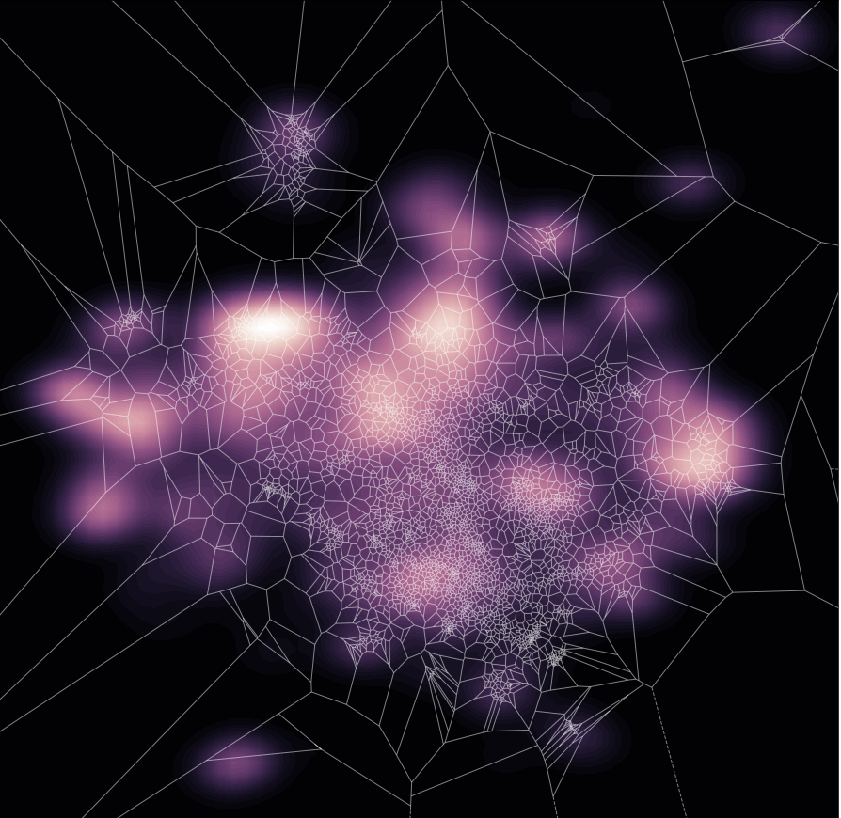

Slide 35









Group similar support cases
Action them together
Fast discovery of emerging issues
Bugs in a new product feature
Identify themes without knowledge
Targeted approach for new documentation

Slide 36
Integration with Jira Service Desk

Slide 37













































Integration
“Webhook” Notification
Query
Action “REST APIs”
Microservices
Data Science (Support)

Slide 38










Integration
Microservices
Requirements & Risks
Webhooks
Notifications from Jira
REST APIs
Interaction with Jira

Slide 39





Building an AI Microservice
What do you need?
Developer
Java/Python
Docker
AWS
Requirements
Analyst / Data Scientist
Python
Quantitative (e.g., statistics, actuarial, mathematics)
Risks
Algorithms
word2vec
classification (XGBoost, scikit-learn)
dimensionality reduction (PCA, tSNE, UMAP)
clustering (K-means)

Slide 40
Building an AI Microservice
Beware of
Access to Data
Don’t assume analytic teams have access to the required data (including Jira instances)
API keys
Requirements
Performance
Machine learning can be slow
Trade off computing power, cost and performance
Risks
Security
Is the service public facing?
Make sure any output is GDPR compliant
Measurement
What metric are you aiming to move?
Important for demonstrated value

Slide 41


Jira REST APIs
REST APIs allow language agnostic interaction with Jira:
Create issue
Edit issue
Modify assignee
Add comment or label
Agile (sprints & boards)
JQL can easily search for issues too:
 | reporter | = | gsims
AND | project | = | SUMMIT
AND | issueType | = | Bug
AND | createdDate | >= | -7d

Slide 42
Python
from jira import JIRA
jira = JIRA(
{'server': 'jira.atlassian.com'}, basic_auth=(user, password)
)
issue = jira.issue(‘SUMMIT-12345’)
issue.fields.labels.append('new_label') issue.update(fields={'labels': issue.fields.labels})

Slide 43
Python
from jira import JIRA
Load package
Connect
jira = JIRA(
{'server': ‘jira.atlassian.com'}, basic_auth=(user, password)
)
issue = jira.issue(‘SUMMIT-12345’)
issue.fields.labels.append('new_label') issue.update(fields={'labels': issue.fields.labels})
Select issue
Add label

Slide 44
Recap

Slide 45
Recap
Artificial Intelligence
Augmenting human decisions with intelligent systems
Examples
Routing, knowledge, topics
Implementation
Jira Service Desk

Slide 46







Hybrid solutions benefit everyone
AND

Slide 47





A match made in heaven

